Slide 1






APPLIED ENGINEERING MATERIALS
SYNTHESIS OF ZINC OXIDE NANOPARTICLE BY SOL-GEL METHOD
PRESENTED BY – SOUMYA RANJAN MAHALI
REGD . NO - 230301120397
Presented by Soumya Ranjan Mahali

Slide 2
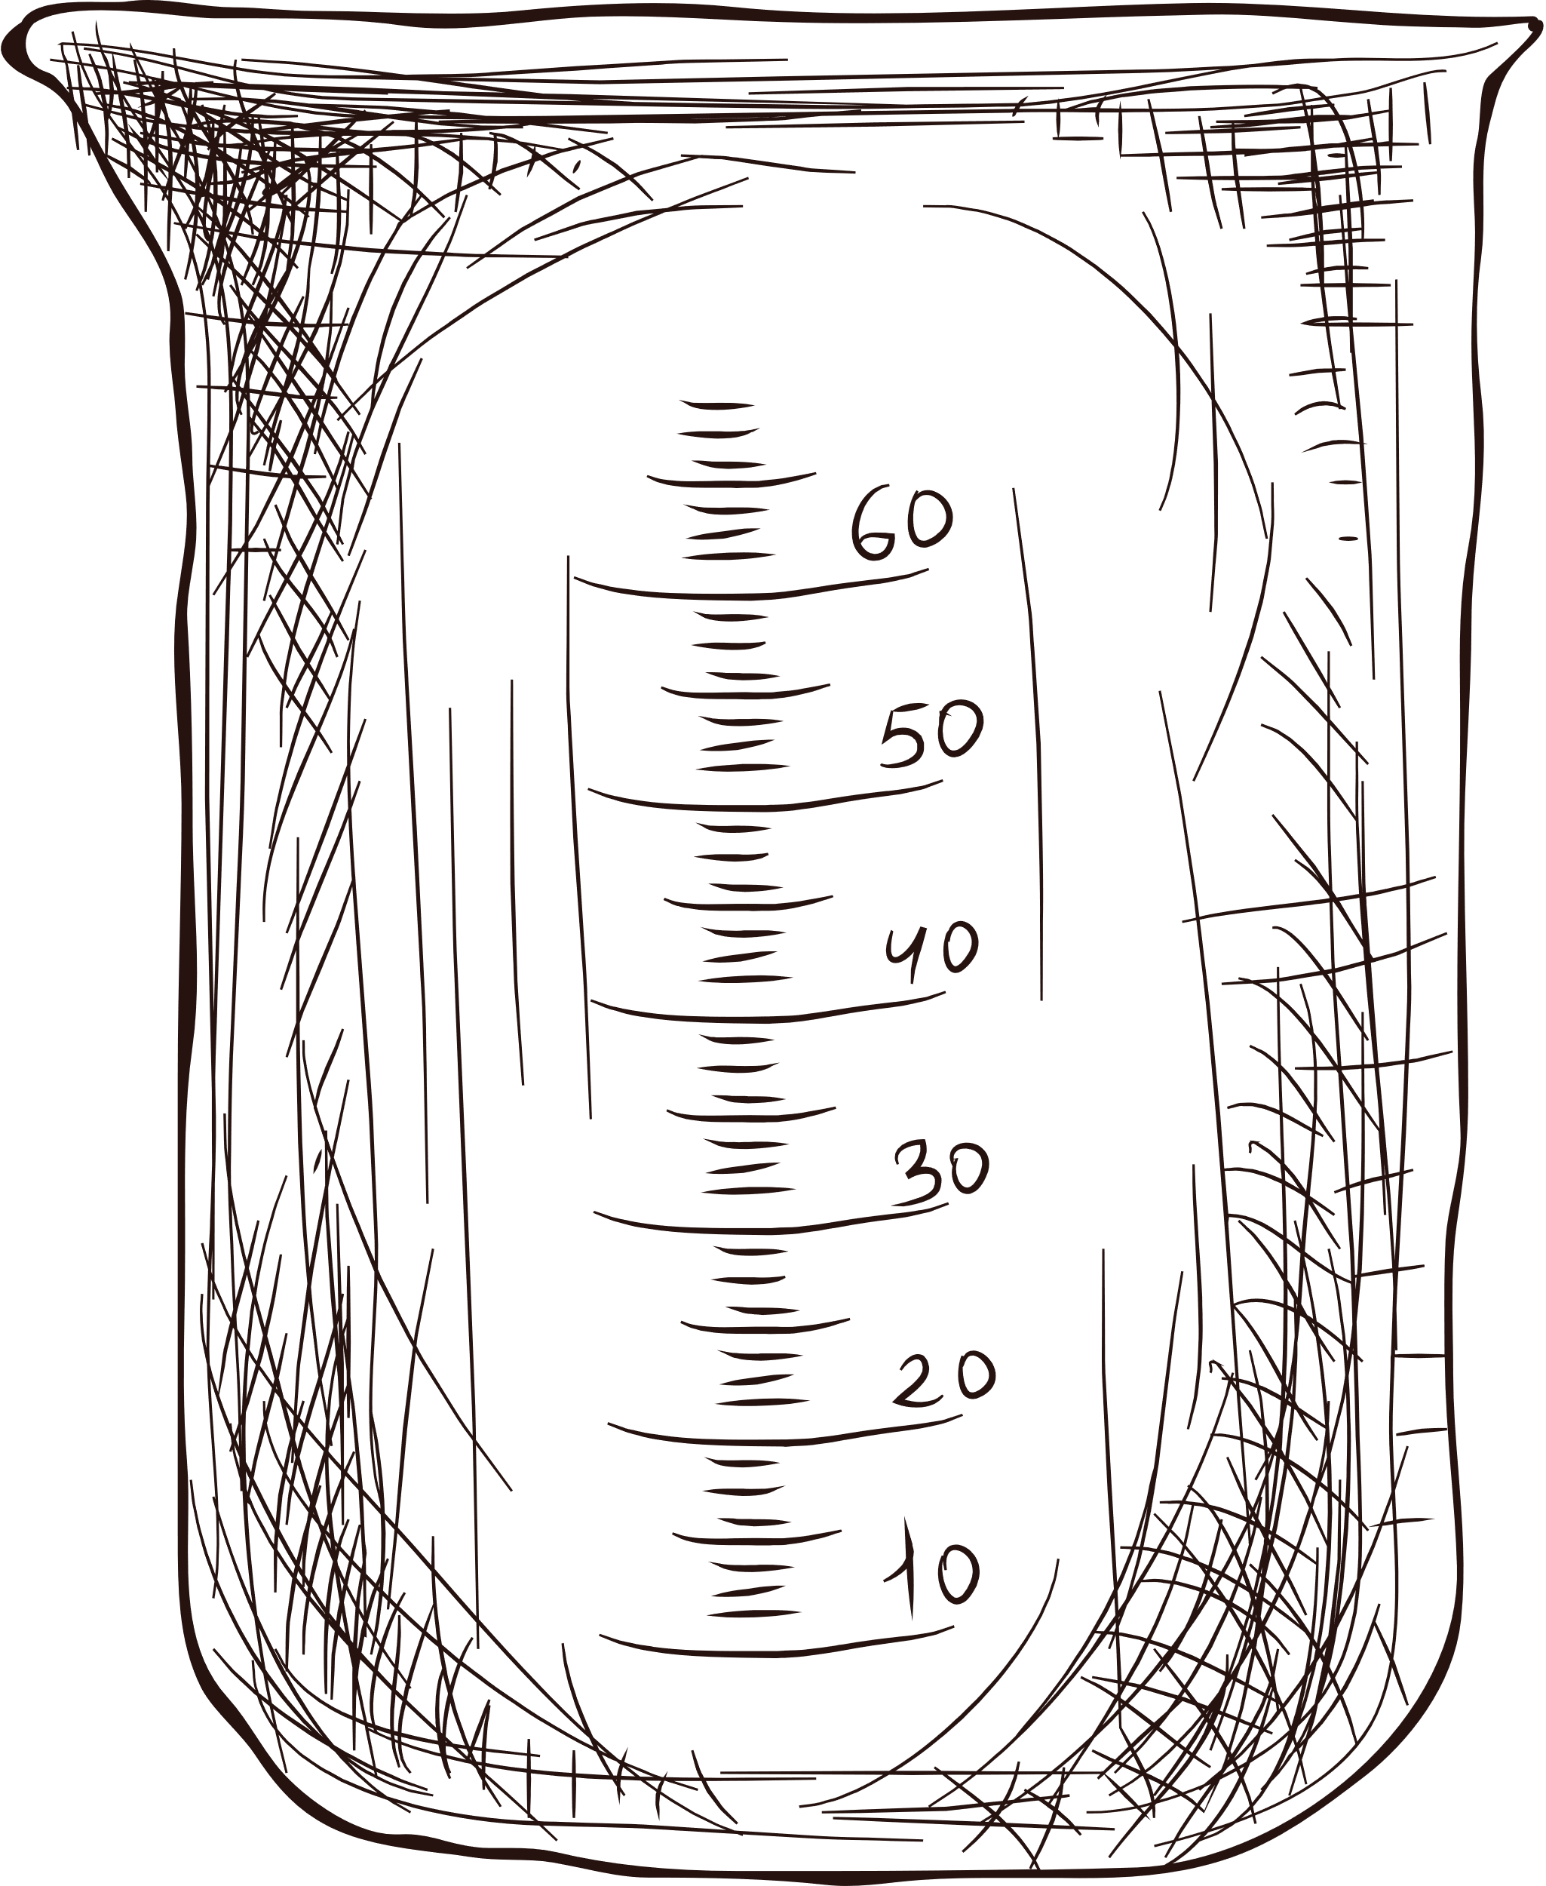

Abstract
The study explores the synthesis of ZnO nanoparticles using the sol-gel method, a simple and effective approach for controlling particle size and morphology. The resulting ZnO nanoparticles showed homogeneous size distribution and good crystallinity, as confirmed by XRD analysis. This successful synthesis demonstrates the sol-gel method's potential for producing high-quality nanomaterials..

Slide 3


What is Zno nanoparticle?
ZnO nanoparticles have emerged as valuable materials in various industrial applications due to their unique properties, including high heat resistance, low electrical conductivity, and antibacterial and anti-corrosion characteristics. Sol-gel synthesis has proven to be an effective method for producing ZnO nanoparticles with tailored properties. Studies by Hasnidawani et al. (2015), Jurablu et al. (2015), and Alwan et al. (2015) have demonstrated the successful synthesis of ZnO nanoparticles via the sol-gel route, achieving particle sizes ranging from 28nm to 100-200nm. Sol-gel synthesis offers simplicity and versatility, making it a preferred method for nanomaterial fabrication. The market demand for the ZnO nano powders is increasing and widely used in industries due to their ultraviolet filtering, catalytic, anti-corrosion and anti-bacterial properties. Recently, they have mainly been used in sunscreens as an ultraviolet-resistant additive. Other applications of zinc oxide nano powder include electrophotography, photo printing, capacitors, protective coatings, anti-microbial, and conductive thin-films in LCDs, solar cells, and blue laser diodes4

Slide 4

EXPERIMENTAL SECTION
01
The sol-gel technique is used to synthesize ZnO nanoparticles in this experiment.
02
Zinc acetate dihydrate, sodium hydroxide, methanol, and distilled water are the materials used in this research
03
Zinc acetate dihydrate serves as a precursor, while methanol acts as a reagent.
04
Distilled water is employed as a solvent.

Slide 5
EXPERIMENTAL SECTION
05
All chemical reagents used in this experiment are of guaranteed grade and are used as received without further purification.
06
The sol-gel method is applied to synthesize ZnO nanoparticles in this experiment.
07
Zinc acetate dihydrate is utilized as a zinc precursor.
08
0.2M zinc acetate dihydrate is dissolved in methanol at room temperature.

Slide 6
EXPERIMENTAL SECTION
09
The solution is then subjected to ultrasonic treatment at 25°C for 120 minutes, resulting in a clear and transparent sol devoid of precipitate and turbidity.
10
0.02M NaOH is added to the sol, followed by ultrasonic stirring for 60 minutes.
11
The sol is left undisturbed until white precipitates settle at the bottom.
After precipitation, the precipitates are filtered and rinsed excessively with methanol to remove any remaining starting material.
12

Slide 7
Result &
Discussion
The synthesis of zinc oxide nanoparticles using zinc acetate and sodium hydroxide in an ethanol solution involves a series of chemical reactions. The hydrolysis of zinc acetate produces zinc ions and acetate ions. The hydroxyl groups (-OH) of ethanol molecules then react with the zinc ions to form zinc oxide nanoparticles. The final product is a result of the equilibrium between hydrolysis and condensation reactions.
The overall chemical reaction to form ZnO nano-powder when sodium hydroxide was used as solvent stated as follow in Eq. (1):
(Zn(CH3COO)2.2H2O)+ 2NaOH ZnO + 2NaCH3COO + H2O (1)

Slide 8
Result &
Discussion
Zinc hydroxide acetate is an intermediate product of the hydrolysis reaction, formed in the presence of H2O and OH- ions. It can be easily transformed into ZnO at higher temperature and with prolonged refluxing. Sodium acetate is water soluble and could therefore be removed from the end product. High purity ZnO nano-powder could therefore be obtained successfully by sol gel technique

Slide 9
Morphological
Study
01
X-Ray Diffractometer (XRD)
02
Field Emission Scanning Electron Microscope (FE-SEM)
03
Uv ray analysis

Slide 10

L
Field-emission scanning electron microscopy (FE-SEM) is a type of scanning electron microscope (SEM) that uses a field emission gun to generate a beam of electrons. This results in a much narrower and more focused beam than is possible with a conventional SEM, which leads to higher resolution images
S E M

Slide 11
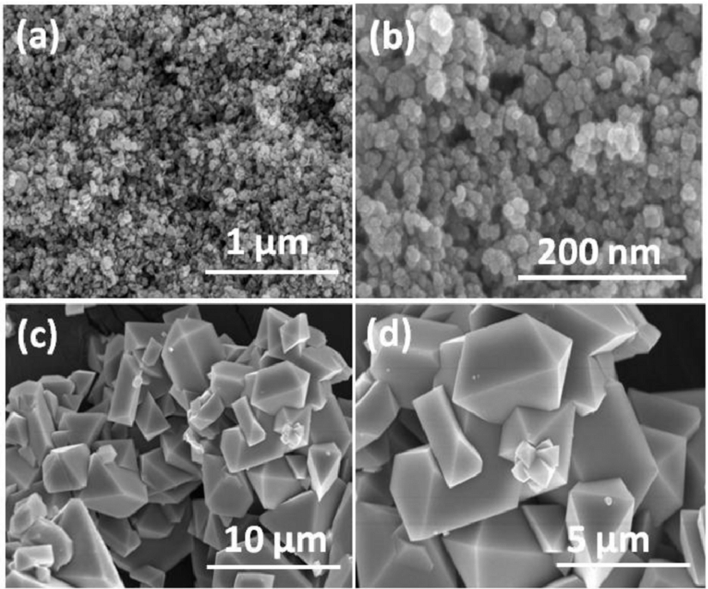
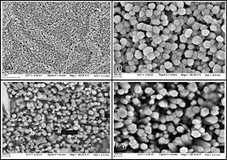
FESEM image of Zno

Slide 12
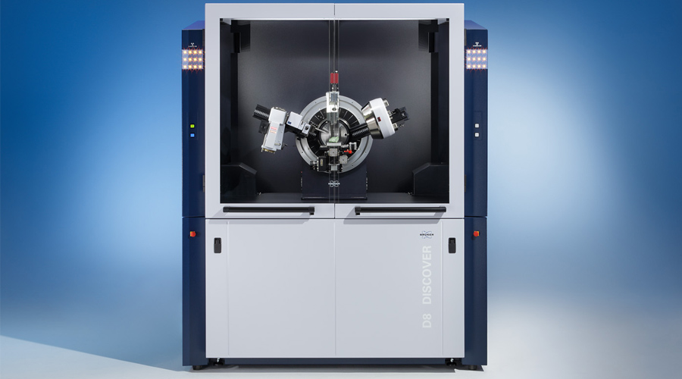
X R D
An X-ray diffractometer (XRD) is a scientific instrument used to analyze the crystalline structure of materials. XRD works by directing a beam of X-rays at a sample and measuring the angles and intensities of the X-rays that are diffracted by the sample. The diffraction pattern is a unique fingerprint of the material and can be used to determine its crystal structure, lattice parameters, and other properties.

Slide 13
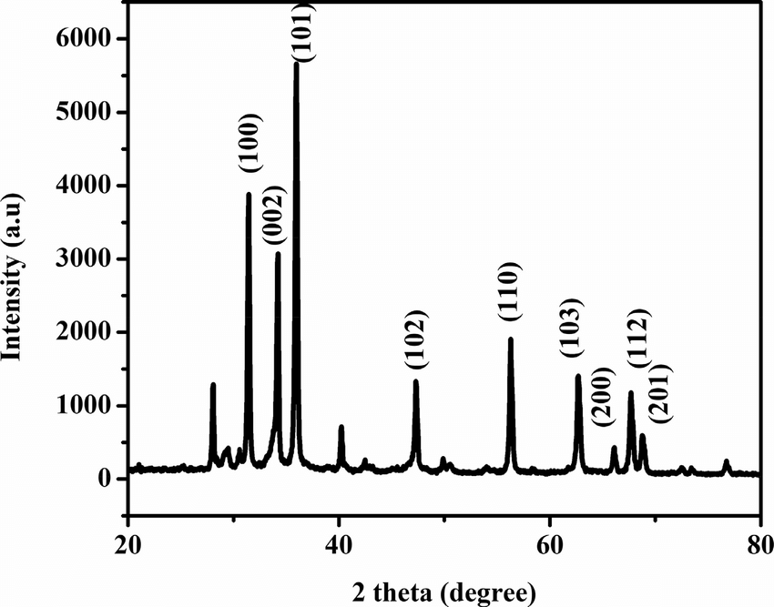
XRD pattern of ZnO nanoparticle
shows the XRD pattern of the pure ZnO nanoparticles prepared during this research work. The average crystalline size of the zinc oxide nanoparticle was found to be 36nm using the Scherrer equation with the width of the peaks at (100) and (101)

Slide 14


Slide 15
Conclusion
01
02
03
The ZnO nanoparticle is successfully characterized such as SEM, XRD and UV-Visible
ZnO nanoparticles can be used in various fields due to its unique properties like low toxicity, biocompatibility and biodegradability. It has a vast range of future applications
The ZnO nanoparticle obtained successfully via sol-gel method

Slide 16
Thank
you!

